Slide 1
Secure Data Hiding in Image Using Steganography
CAPSTONE PROJECT
Presented By: Makwana Nidhi Hareshbhai
Student Name : Makwana Nidhi Hareshbhai
College Name & Department : Gujarat Technological University (Information Technology)

Slide 2
OUTLINE
Problem Statement
Technology used
Wow factor
End users
Result
Conclusion
Git-hub Link
Future scope

Slide 3
Problem Statement
In the digital era, secure communication is a growing concern due to the risk of unauthorized access and data breaches. Traditional encryption methods can attract unwanted attention, making them vulnerable to attacks. This project aims to develop a steganography tool that enables users to hide sensitive data within images, ensuring confidentiality without raising suspicion. By embedding information in digital images, the tool provides a covert and efficient means of secure data transmission.

Slide 4
Technology used
Programming Language : python

Slide 5
Wow factors
Developed User–Friendly GUI for effective interaction.
Hiding information into Image and also decrypt just by entering passcode.

Slide 6
End users
Steganography is used by a variety of individuals and organizations for different purposes, including:
1. Cybersecurity Professionals – To securely transmit sensitive information without attracting attention.
2. Journalists & Whistleblowers – To share confidential reports or evidence while avoiding censorship or surveillance.
3. Law Enforcement & Intelligence Agencies – For covert communication and cyber investigations.
4. Corporate Organizations – To protect trade secrets and intellectual property from industrial espionage.
5. Ethical Hackers & Penetration Testers – To test security systems against steganographic threats.
6. Researchers & Academics – For studying and improving data hiding techniques in digital media.
7. General Privacy-Conscious Users – Individuals who wish to keep their personal communications private.
While steganography has legitimate uses, it can also be exploited for malicious activities, making awareness and ethical use critical. 🔒

Slide 7
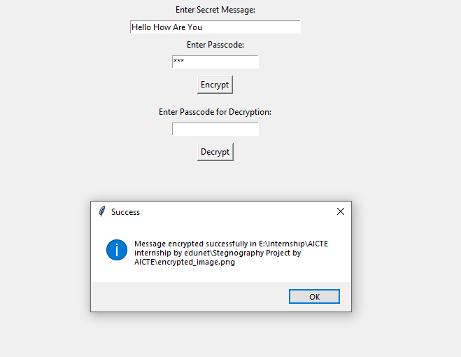
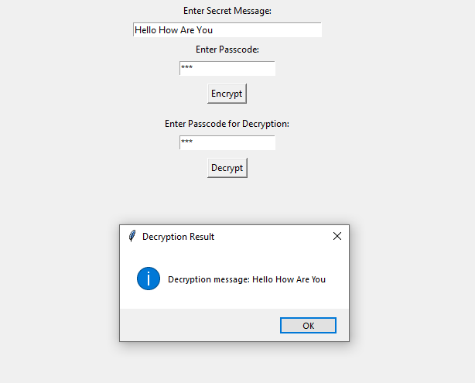
Results

Slide 8

Results
Encrypted Image:

Slide 9
Conclusion
This steganography tool effectively addresses the challenge of secure data transmission by embedding sensitive information within digital images, ensuring confidentiality without drawing attention. By incorporating advanced encoding techniques, encryption, and error detection, the tool enhances security and usability. Its resistance to steganalysis and user-friendly interface make it accessible for both technical and non-technical users. Ultimately, this project provides a reliable and covert solution for secure communication in an increasingly digital world.

Slide 10
GitHub Link
https://github.com/Nidhi-Makwana/Stegnography-Project.git

Slide 11
Future scope
The future scope of this steganography tool includes several potential advancements:
1. AI-Powered Steganography – Implementing machine learning algorithms to optimize data embedding and enhance steganalysis resistance.
2. Video & Audio Steganography – Expanding functionality to hide data within video and audio files for broader application.
3. Cloud-Based Integration – Developing a cloud-based version for secure remote data embedding and extraction.
4. Real-Time Steganography – Enabling real-time secure messaging using steganographic techniques.
5. Blockchain Security – Leveraging blockchain to ensure authenticity and tamper-proof hidden messages.
6. Mobile App Development – Creating Android and iOS applications for on-the-go secure communication.
7. Quantum-Safe Encryption – Incorporating quantum-resistant encryption methods for future-proof security.
These enhancements will increase the tool’s versatility, security, and usability, making it a cutting-edge solution for secure data transmission. 🚀

Slide 12
THANK YOU

